Slide 1
2016 to 2020 Revised Regulatory Proposal
9 March 2016

Slide 2
Overview
Our RRP:
Adopts many of the AER’s Preliminary Decision (PD) positions
Provides a prudent investment plan to maintain our network and meet our customers’ needs and expectations.
Our RRP will allow us to:
Continue to be lowest cost DNSP (AER 2015 Annual Benchmarking Report)
Continually improve our cost efficiency and share these with customers
Arrest our performance deterioration and meet our service level targets
Respond to changes in our operating environment including new regulatory obligations
The AER’s PD rejected some components of our RP:
If AER maintains these decisions in its Final Decision we will experience a cost recovery shortfall – would fail to meet the NEO.
Our RRP sets out alternative positions to ensure efficient very and effectively promote the optimal NEO position.

Slide 3
Total Capex
Our revised forecast is efficient and promote the optimal NEO position.
We have reduced capex from $1,104.0m to $1,052.9m.
Total capex ($M 2015) | RP | AER PD | RRP
Augex | 166.5 | 127.0 | 124.3 | Accept
Connections | 249.1 | 249.1 | 316.8 | Revised
Repex | 585.1 | 413.9 | 563.6 | Do not accept
Non-network – ICT (base) | 102.1 | 103.6 | 103.6 | Accept
Non-network – ICT (POC/RIN) | 61.6 | 0.0 | 49.8 | Do not accept
Non-network - Other | 30.9 | 30.9 | 30.9 | Accept
Escalation adjustment | 0.0 | (18.4) | 0.0 | Accept (included above)
Total Gross Capex | 1,195.3 | 906.1 | 1,189.1
Customer Contributions | (91.3) | (91.3) | (136.1) | Revised
Total Net Capex | 1,104.0 | 814.8 | 1,052.9

Slide 4
Connections
RRP forecast is $316.8m - $67.7m (27.2%) increase from RP forecast of $249.1m
Increase calculated using (i) our original forecasting method and (ii) corrected volumes and project costs - using more up to date information
Two thirds of the increase will be recovered through up-front contributions from developers
Our customer contribution forecast has increased by $44.8m to $136.1m.
Driver | Increase | Reason
Volumes | 7% | Business supply & multi-occupancy projects due to low interest rates & high housing demand
Project costs | 19.3% | More large projects - rail crossings, road works, and building developments in built-up areas.
Existing Horizon Projects | 0.8% | New committed large Business Supply projects

Slide 5
Repex
Our RRP is structured around the assessment categories in the AER’s PD
Repex forecast | 11 to 15 Allowance | 11 to 15 Actual | AER PD | RRP
1. Modelled Repex |  | 234.8 | 220.3 | 266.8
2. Pole Top Structures and SCADA |  | 132.3 | 130.1 | 131.4
3. Other – Un-modelled |  | 45.5 | 28.0 | 112.2
4. VBRC |  | 24.4 | 35.5 | 53.3
Total | 368.1 | 437.0 | 413.9 | 563.6

Slide 6
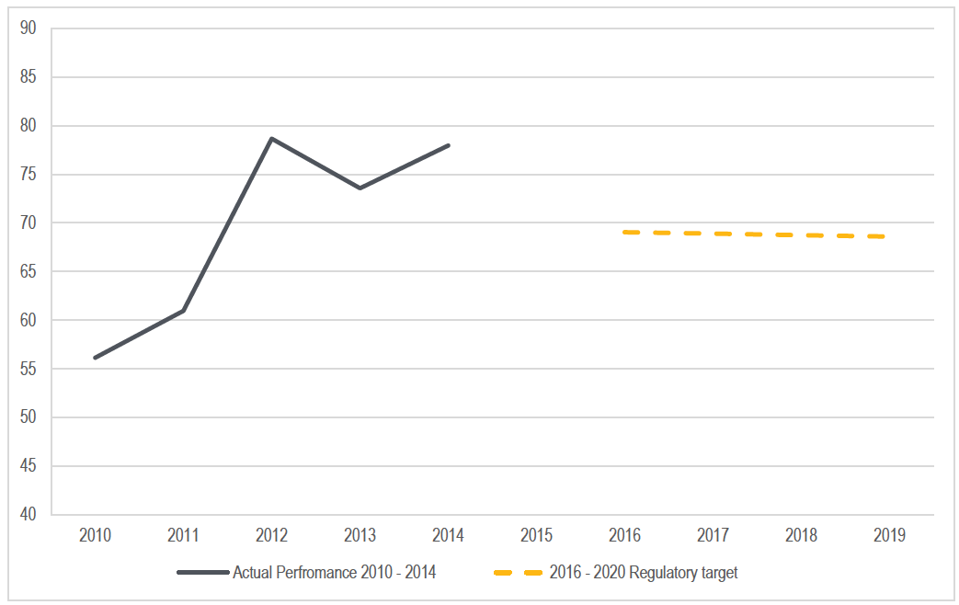
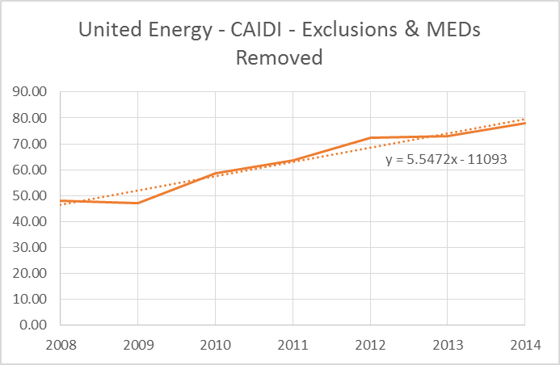
Repex - Misunderstandings in AER PD
1. Reliability | AER considers our performance has not deteriorated, whereas it has
AER Figure 6.15 – relies on incorrect data We incurred $40m in STPIS penalties between 2011-14 Our CAIDI has deteriorated We exceeded our 2011-15 Repex allowance by around 20%
Unplanned SAIDI Unplanned CAIDI

Slide 7
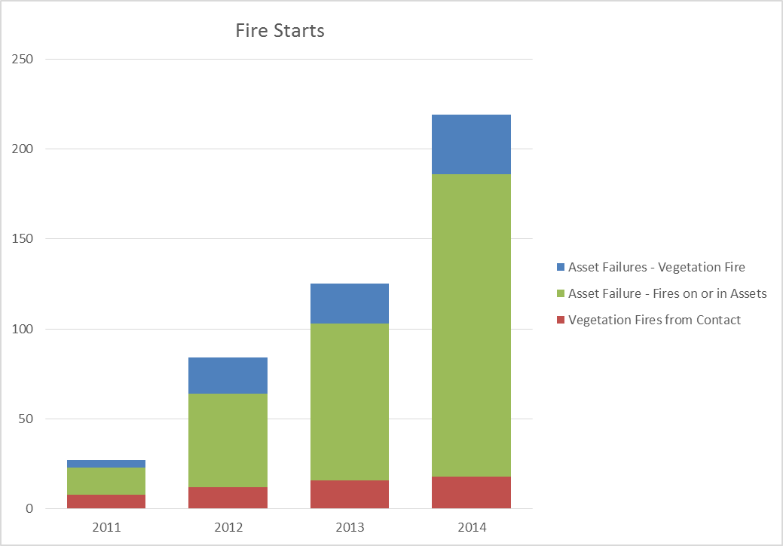
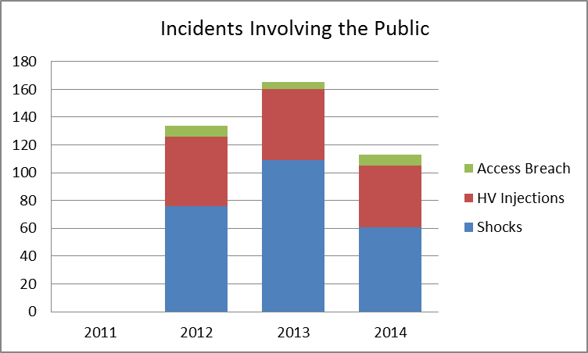
Repex - Misunderstandings in AER PD
2. Safety | AER considers that this is being maintained, whereas in fact it is not
AER Figure 6.15 – relies on incorrect data AER’s Metrics focus exclusively only on asset failures – our safety performance for asset failures and fire starts is clearly deteriorating ESV’s 2014 Safety Performance Report found that we had an “increase in fire numbers and asset failures”

Slide 8
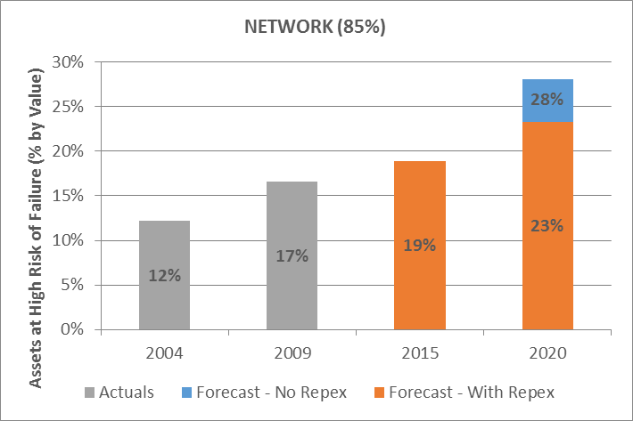
Repex - Misunderstandings in AER PD
3. Asset Failure | AER considers that this is not increasing, whereas in fact it is
AER’s Residual life metric is not a proxy for asset condition Assets that exceed 85% of the end of asset life are at high risk of failure In 2015, 19% of our assets are at end of life – this will increase to 28.1% or $800m if the AER does not approve our Repex.

Slide 9
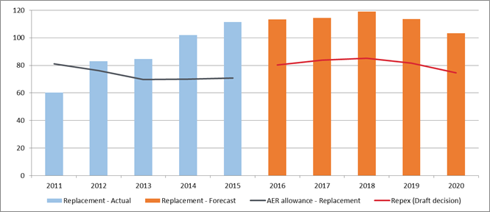
Repex history
$m real 2015

Slide 10
Repex
Overall Repex is our biggest exposure area
Modelled repex
Concerned with how the AER is reviewing the forecast and model based on our submission and expert advice provide by Dr Brian Nuttall
Un-modelled
Revised our business cases to ensure they are robust
Applied a top down assessment to verify the efficiency of our forecasts
VBRC

Slide 11
ICT
Power of Choice Rules are largely finalized so the projects should now be assessed for prudency and efficiency
Reduced our forecast consistent with the finalised rules – removed our forecast to comply with multiple trading arrangements
Confident the AER is reviewing the projects based on the finalised rules

Slide 12
Total Opex
Our revised forecast is efficient and promotes the optimal NEO position.
We have reduced opex from $800m to $780m.
Total opex ($M 2015) | RP | AER PD | RRP
Efficient base year | 615.7 | 625.1 | 629.7 | Minor adj.
AMI transfer | 94.4 | 0.0 | 61.9 | Do not accept
Rate of change | 15.1 | 28.8 | 28.8 | Accept
Step changes | 53.8 | 2.4 | 41.6 | Do not accept
GSL’s | 1.1 | 2.2 | 7.0 | Do not accept
DMIS | 6.6 | 2.0 | 6.6 | Do not accept
Debt raising costs | 13.7 | 5.5 | 5.8 | Accept
Total Opex | 800.4 | 666.0 | 781.4

Slide 13
AMI transfer
We largely accept the AER’s approach in establishing total costs for this activity
The issue is whether the costs are recovered under SCS or ACS(AMI)
The AER’s approach is to leave all costs under ACS
This approach distorts prices, markets and future competition
The AER’s approach to wait until competition starts will transfer the costs at that point anyway
AMI price is too high until then and will create a price that will be not reflect the medium term market
There is enough information available to establish the correct cost allocation now to fairly set up the market price and future competition
Needs to be consistency across the NEM and future benchmarking

Slide 14
Step changes
Reduced our step change proposal to be consistent with the approach adopted by the AER in establishing the base year cost and rate of change calculations
Regulatory changes like Power of Choice and RIN reporting – with the AER for assessment
Change in cost profile
Meter testing – obligation that has existed since 1999 however has not been allocated to SCS due to AMI program (costs capitalized as part of AMI installation). Requirement to test – remote testing the optimal solution
IT security – Exogenous to rate of change allowance. Not growth related, step change in IT requirement due to enhanced security
Safety – ESV changes to the ELC in particular stakeholder engagement

Slide 15
Depreciation
We have applied the “year-by-year tracking approach” – per the AER’s SAPN Final Decision - to determine remaining asset lives in each asset class.
Satisfied that the AER approach applied for SAPN is satisfactory for UE

Slide 16
Cost of capital
Cost of Equity
Approach per original submission
Moving in line with interest rates is not a fair reflection of the cost of equity
Tribunal has ruled reasonably conclusively on this issue
Gamma
Approach per our original submission
Tribunal has ruled reasonably conclusively on this issue
Cost of debt
Our approach has changed for the Revised Proposal
Path forward remains unclear

Slide 17
Other issues
EBSS
The AER needs to establish a consistent cost base in its approach – 2010 cost base used by the AER is incorrect
DMIS
Allowance is too low for meaningful innovation
AER should create a central pool for business to “bid”
Stakeholder engagement
There was clear support for a council step change that should be reconsidered by the AER

Slide 18
Thank you and questions

