Slide 1
Stakeholder Engagement Framework
Workshop 23 February 2017
Session 2 – The Framework
Notes:
1

Slide 2
The Framework
Do we need it?
Is it fit for purpose?
How relevant is it?
What needs to be in it?
What can be dealt with in other ways?

Slide 3
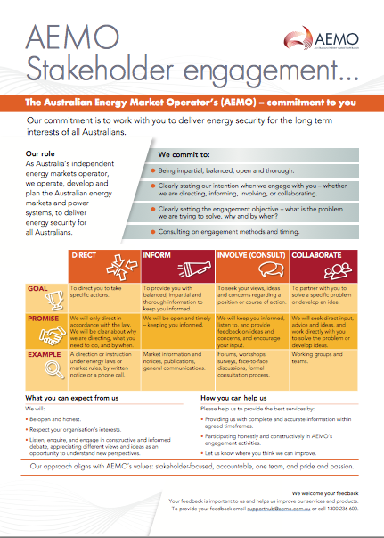

Slide 4
Implementation
How effectively is it being implemented?
Consistency
  Is the Framework being applied consistently?
  Is there an argument for different approaches to accommodate the range of AER work (proportionate engagement)?
Duplication (within and outside the AER)
  Minimising drain on stakeholder resources
Are the outcomes being sought clear?

Slide 5
An alternative approach
Example: UK Sustainability First uses overarching objectives
Legitimacy
  to give stakeholders a voice in decision-making
Consumer outcomes
  to address market failures & inform thinking on how to deliver more efficient, innovative & value for money services
Cultural
  Influence behaviour and culture change in the energy sector, i.e. helping customers and companies actively engage
Is this an approach we should consider?

Slide 6
Measurement
How should we monitor and report on our engagement activities?
  Measure against expectations (matrix)
  Submissions template to formalise input – consideration – decision chain
  Biennial surveys
  Exit surveys
Who does it well?

Slide 7
Recap: break out questions
The Framework: Do we need it? It is relevant? What should be included in it?
Would a shorter document be more useful?
How effectively have we implemented the existing Framework?
Should we consider alternative approaches, like including overarching objectives? What would this add?
How should we monitor and report on our engagement activities? Who does it well?

Slide 8

Finally….

