Slide 1
Jemena Electricity Networks 2021-26 Electricity Distribution Price Review Public Forum 22 April 2020

Slide 2
Agenda
Who is Jemena?
Our Proposal Delivers
We address affordability concerns
Benefits to customers
Our customer engagement journey
The six-month intervening period
Revenue requirement
Operating expenditure
Capital expenditure
The future network
Our Regulated Asset Base
Charging customers through efficient network tariffs
Our People’s Panel sharing their views

Slide 3
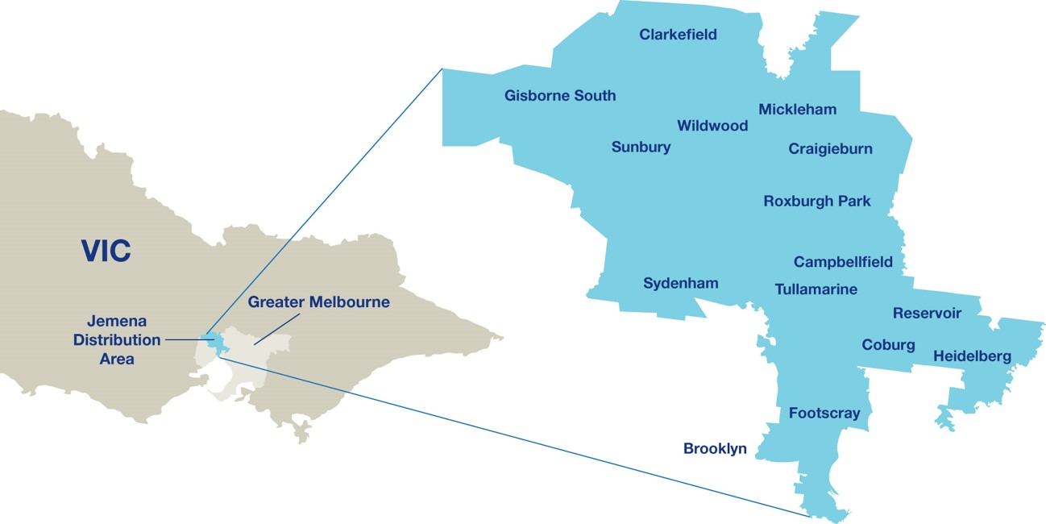
Who is Jemena? | Jemena Electricity Networks
Jemena Electricity Networks owns and operates the electricity distribution grid in the greater north-west of Melbourne
We provide distribution services to our customers
Notes:
Jemena is an energy infrastructure business owning and operating over $10b worth of gas and electricity assets in eastern Australia.
Jemena Electricity Networks—a subsidiary of Jemena—owns and operates the electricity distribution grid in the greater north-west of Melbourne
We provide a range of distribution services to our customers, mostly focused on delivering electricity to residences and businesses in our distribution area, but also providing public lighting and metering services.

Slide 4
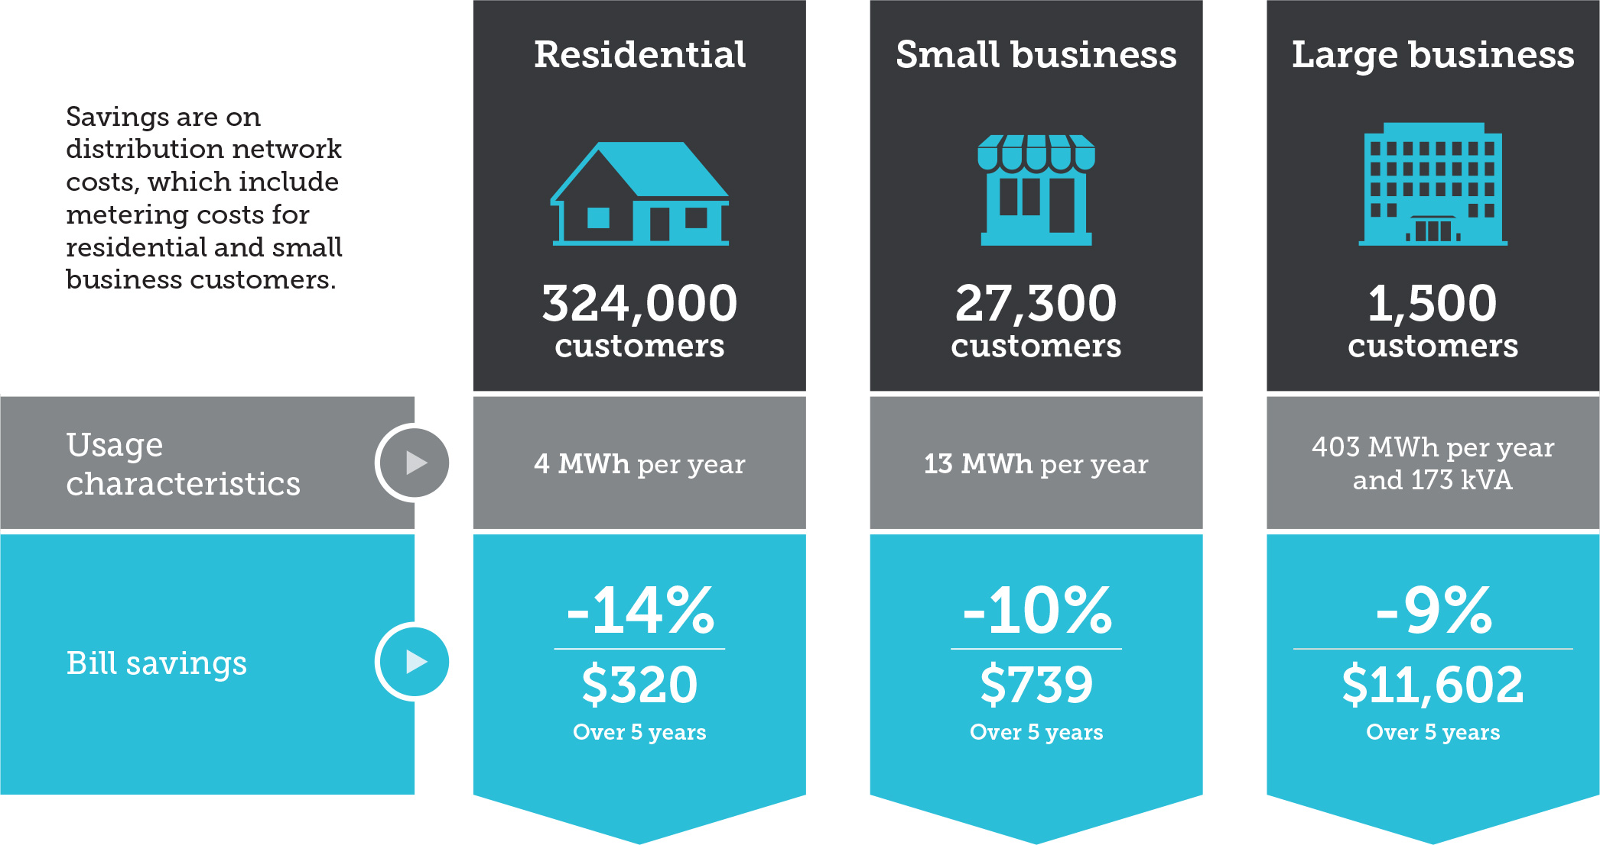
Our Proposal Delivers | We address affordability concerns
Notes:
We have heard from all of our customers--residential, small business and large industrials--that affordability remains a key issue
We have therefore sought to target price reductions to all customer segments equally for the network services we provide
Our residential and small business customers who receive smart metering services will see an even greater price decreases
Our customers also told us price certainty is important; for this reason, we propose the revenue requirement reductions are adopted in the first year and held constant in all other years.
[Note: Bill reductions are estimated based on the average of the network charges over the 2016-20 period versus the 2021-26 period in real $2021]

Slide 5
Our Proposal Delivers | We address affordability concerns (2)
Notes:
From an average revenue per customer perspective we are delivering greater affordability. Our customers enjoy bill reductions through lower costs in the building block model, and also through the smearing of costs across a larger customer base.

Slide 6
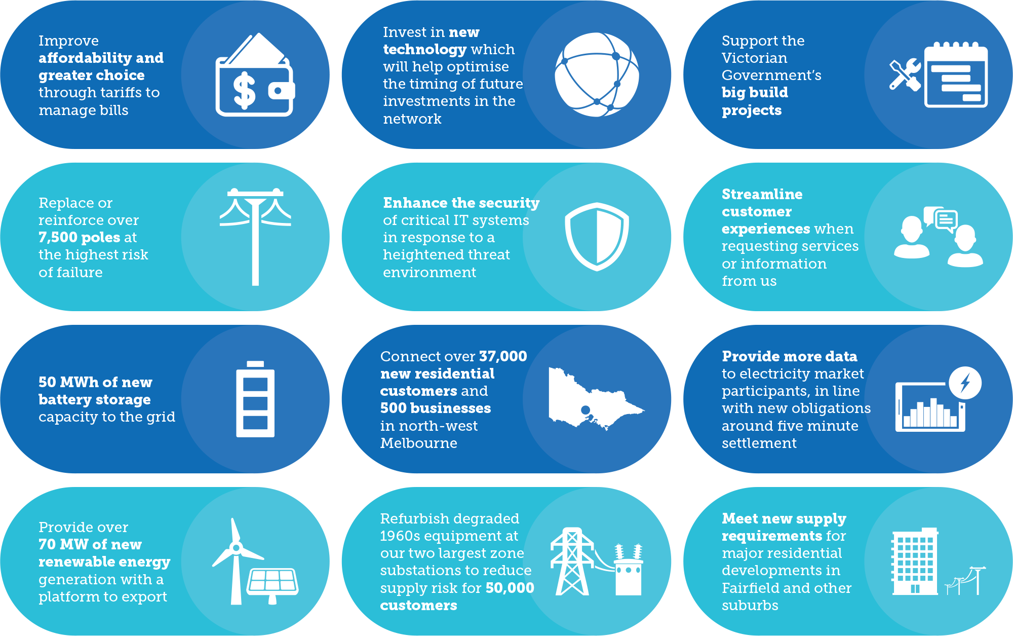
Our Proposal Delivers | Benefits to our customers
Notes:
We have sought and developed the latest market projections and took on board our customer preferences to identify a range of benefits to our customers. We have summarised some these benefits on this chart, however, a few key points are worth noting:
We will connection 37,000 new customers to our electricity network, this is an increase of more than 10%
We will connect large amounts of renewable generations and battery storage
We will maintain our network to manage a growing number of extreme weather events
We will leverage technology to optimise the way we run our network and provide services to customers

Slide 7
Customer Engagement | Our customers shaped our plans
In 2019 Jemena was recognised for excellence in customer engagement winning the coveted industry award and being the only energy business shortlisted for the Australasia IAP2 awards
7
Notes:
We set out with the intention of having our customers shape our proposal and to do more than we have dome in the past
We focused on the IAP2 values, in particular, those customers impacted by the outcomes, should have a say in the decision
Our journey started by asking our customers how they would like to engage with us
Each type of customer had different needs, and we shaped our program accordingly:
large customers and electricity retailers preferred to meeting one-on-one
councils preferred to collaborate amongst each other
small businesses were time poor and preferred short surveys
For our community, we formed a representative “peoples panel” to seek their views.
We are committed to continuing our engagement, however, this will be more challenging with social distancing requirements. Adapting to this new environment, we will:
Be dynamic with our customer engagement
Engage our People’s Panel where we can
Gain feedback from customer advocates and our customer council
Keep our customers informed

Slide 8
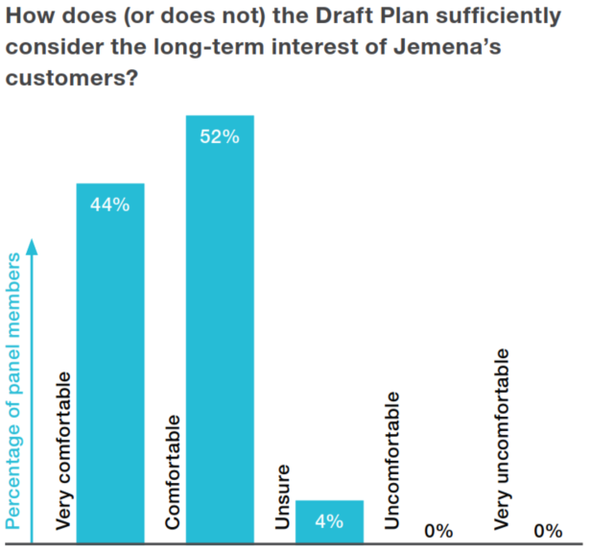
Customer Engagement | We heard from all our customers
Large businesses
Peoples panel (community)
Key feedback
Affordability
Reliability
Affordability
Reliability
Greening the grid
Small businesses
Affordability
Support for our plan
Local councils
Public lighting
Energy Efficiency
Demand management
Retailers
Tariff structures
https://yourgrid.jemena.com.au/draft-plan/widgets/261135/videos/18795
We incorporated all of our customers’ feedback into our plan
Notes:
Our Peoples Panel
Our people's panel emerged themselves in a range of activities over a year and shared their views with us. No issue was out of scope.
Overall we received 25 recommendations from the Panel. Some of these we can action, but others relate to issues in policy or other parts of the supply chain:
where we could effect change, we listened and acted
where the Panel's concerns related to other parts of the electricity chain, we advocated on behalf of the panel members
We implemented all of the recommendations into our regulatory proposal
We tested the plan with our customers, and they gave us overwhelming support confirming that our plan met the long term interests of customers.
Our other customer types also expressed their concerns:
Large businesses had a mix of interests, some relating to reliability and others relating to costs.
Affordability was a key theme of small business customers
Local councils were interested in technologies
Retailers expressed the greatest interest around network tariffs

Slide 9
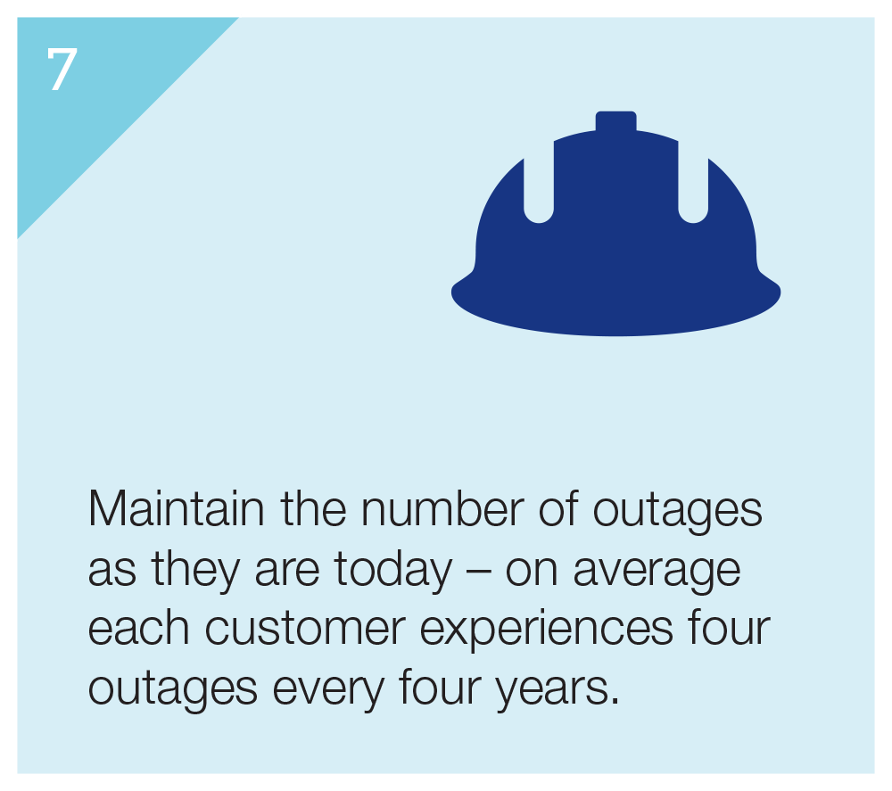
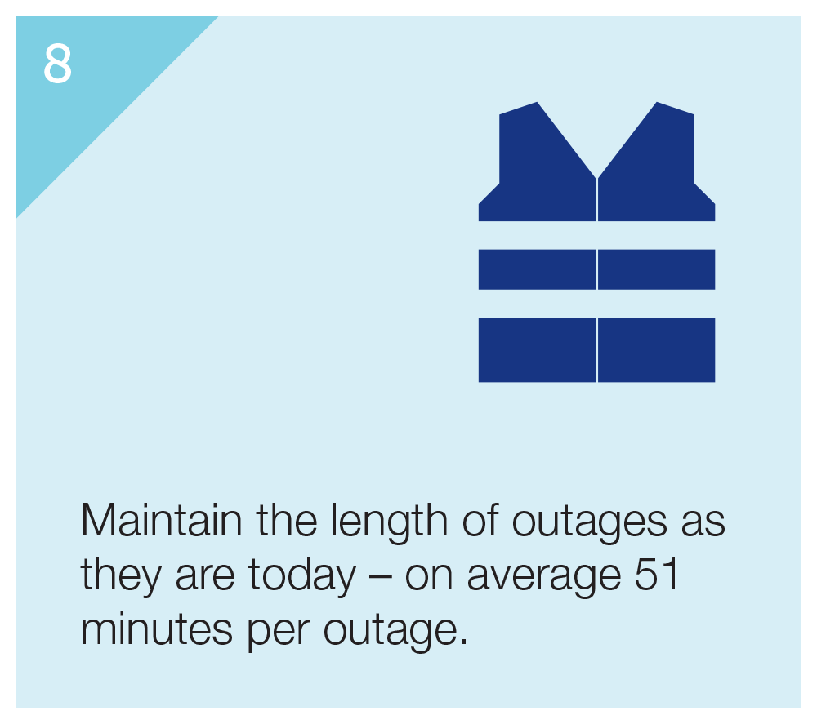
Customer Engagement | Shaping our business
Notes:
Drawing on the insights our customers shared with us, we have developed the energy trilemma of sustainability, reliability and affordability. This framework creates a tension in that each objective is independent of the others, and yet our customers challenge us to address all of these issues. Focusing on getting the balance right across each of these elements, we believe our regulatory proposal meets these objectives.
In our consultation we asked our customer where safety rated in their priorities, their overwhelming response was that safety is a given and this should not be compromised.

Slide 10
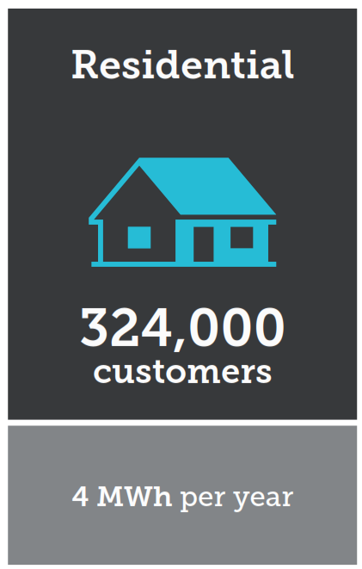
Revenue Requirement | Six-month intervening period
A simplified approach to determining revenues
Outcomes
We are trending capex and opex
(and proposing to expense overheads)
2018 rate of return guideline will apply
Incentives schemes will apply (but not CESS)
DUoS
&AMI
-13.4%
Network services
AMI services
Building block item | CY20 revenue requirement $M (50%)⁽¹⁾ | Intervening period revenue requirement $M | CY20 revenue $M requirement (50%)⁽¹⁾ | Intervening period revenue requirement $M
Return on capital | 48 | 36 | 2 | 1
Depreciation | 29 | 21 | 6 | 3
Operating expenditure | 50 | 57⁽²⁾ | 7 | 7
Corporate income tax allowance | 8 | 3 | 1 | 0
Other adjustments⁽³⁾ |  |  | -2
Total revenue requirement | 134 | 118 | 14 | 12
Percentage change in customer bill
-12%
-14%
(1) AER 2016-20 Decision for JEN; (2) Driven by expensing of corporate overheads, (3) 2016 pricing adjustment
Notes:
As a part of the regulatory process, we are changing the regulatory period from a calendar year basis to a financial year
To make this change, the usual regulatory processes don’t quite work; we need to be more dynamic.
Following the AER’s preferred approach, we are:
trending forward our operating expenditure and capital expenditure for the six months
applying the 2018 Rate of Return Instrument
proposing making an adjustment to expense corporate overheads in accordance with our Cost Allocation Methodology changes.
All of this equates to a 13% reduction in network and metering charges to our residential customers

Slide 11
Revenue Requirement | What’s changed
Notes:
We estimate the revenue we require using the AER’s building block model. There have been several drivers that have driven the reduction in revenue we require:
The return on capital reduced due to the significant reduction in the rate of return from 5.69% to 4.80% driven by market movements
Advanced metering infrastructure charges have reduced significantly due to material reductions in the asset base and reduction in the rate of return
We have changed our accounting policy, which means we are expensing our corporate overheads, rather than capitalising them; this is in accordance with the change in our cost Allocation Methodology that was approved by the AER.
Our net Opex and EBSS has lifted marginally, most due to a substantial increase in expected bush-fire insurance premiums
Tax allowance reduced because of lower revenue from a lower rate of return
CESS revenue increased because of the underspend in capital relative to the regulatory allowance and because there was no CESS scheme in place during the 2016-20 regulatory period.

Slide 12
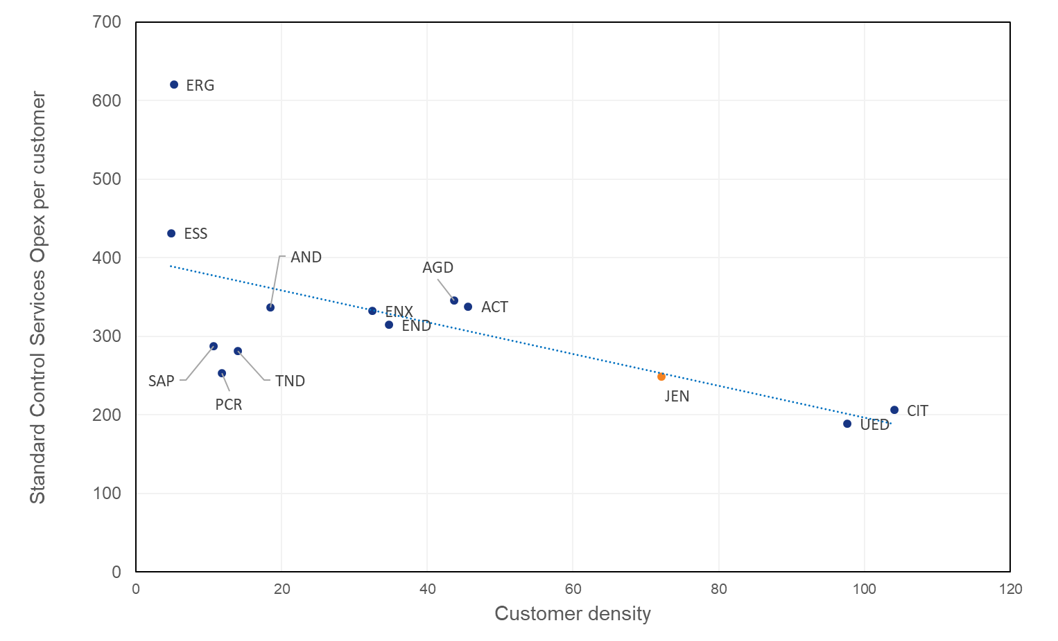
Building Block Model | Operating Expenditure
Our partial productivity opex is efficient …
… and our proposal continues this trend
Notes:
Opex benchmarking
The AER adopts several techniques for assessing operating expenditure efficiency. On some of these measures, JEN does not perform well. However, on the AER’s preferred Partial Productivity Indicator (PPI), JEN performs very well.
This disparity in operating expenditure benchmarking performance means that its weight in decision making should be “measured”, and indeed not deterministic.
Our opex proposal
In the next regulatory period, we adopt the AER’s preferred base step and trend approach to forecasting operating expenditure.
In selecting the base year, we have chosen the year (over the current regulatory period) with the lowest operating expenditure, namely 2018. From here, we launch our opex projections.
We had adopted several step changes, reflecting the changing regulatory requirements and market conditions; these include:
An uplift in insurance premiums – attributed to the global increase in bushfire risk
Cybersecurity – to manage growing security risks
Several regulatory changes – EPA requirements and changes to our operations due to the shift in the regulatory period.
We have also moved to expense our corporate overheads (rather than capitalising them), reflecting the changing nature of our expenditure. We have communicated this with the AER throughout latest CAM changes.
SCS Opex including debt raising costs (real $2021):
Total base expenditure (excl specific forecasts) = $496M (includes change in treatment of Corp. overheads = $62M)
Total trend = $26M
Total specific forecast (excl overheads) = $12M
Step changes = $42M
Total opex = $577M
(Corp overheads change impact is $62M)

Slide 13
Building Block Model | Operating Expenditure step changes
Recent changes drive updated cost forecasts
Operating expenditure step change | Total (5 yr)
Insurance premiums | 28.8
Inspection of REFCL equipment | 1.3
Future Grid program | 3.8
Transitional hedging costs | 0.9
Environment Protection Act changes | 4.2
Cybersecurity | 2.9
Additional RIN reporting | 0.5
Total | 42.4
Global insurance market respond to bush-fire events
New obligations have arisen
Necessary to meet security standard for DNSPs
Specific forecasts (increments from current period shown) | Total (5 yr)
Guaranteed Service Level payments | +0.1
ESV levy (new) | +1.4
Debt raising costs | +0.6
Total | +2.1
ESV has expanded and increased its programs
Real June 2021 $m
Notes:
Changes in our operating environment mean that we can incur incremental operating expenditure over and above trended amounts. New regulatory obligations or movements in markets—often beyond management’s control—can cause these incremental costs to arise.
In our proposal, we seek to recover these forecast incremental expenditure items through step change allowances.
Several step changes are substantial in magnitude, in particular the bushfire insurance premium. Shifts in the global insurance market drive this incremental cost. While we seek to procure only the most efficient insurance coverage, our best estimate is still substantially higher than the historical trend.
New EPA obligations, keeping up with ever-evolving cyber security challenges and smartening the grid (which we elaborate on later), also contribute to an uplift in expected operating expenditure.

Slide 14
Building Block Model | Capital Expenditure
Proposed capex is in line with current period, with compliance obligations a key driver
Lower than ‘threshold’ repex forecast modelled using the AER’s methodology
Forecast increases due to some safety/bushfire risk-driven asset replacement programs
Strong demand for customer-funded asset relocation works
General connections expenditure in line with growth trends
Major projects forecast individually
Net connections expenditure in line with current period
Proposed total capex $781M (gross)
Our capex forecast responds to feedback from customers through our engagement program
Notes:
Total SCS capex
Our capex forecast is in line with spend during the CY16-20 regulatory period
Capex per customer will continue to fall during the next regulatory period
Our capex forecast has been developed to respond to customer feedback from our engagement:
Affordability – JEN should spend efficiently
Sustainability – customers want to connect more distributed energy resources (DER) to the grid, and expect JEN to play an enabling role in new technologies and energy markets
Reliability – customers expect JEN to keep the network as reliable as it is today.
Replacement
The modelled portion of our replacement expenditure forecast is 6% lower than the ‘threshold’ modelled repex forecast using the AER’s methodology
Key drivers of our replacement expenditure forecast include:
Ongoing replacement programs to ensure the safety and reliability of assets such as poles and cross-arms, including in Hazardous Bushfire Risk Areas
An increase in some replacement programs targeting specific asset types/families – such as overhead services and low voltage mains in Hazardous Bushfire Risk Areas
A shift from our recent focus on the replacement zone substation transformers, towards focussing on zone substation switchgear and secondary equipment. This includes major projects to replace 1960s equipment in zone substations at Coburg North, Coburg South and Footscray West
Strong demand from customers for network asset relocation works, which are almost entirely funded through up-front customer contributions.
Connections
General connections expenditure is in line with longer-term customer growth trends – e.g. residential customer numbers are forecast to grow at an average of 2.1% per annum
Major customer connections projects are individually identified through discussions with our largest customers, and these projects are forecast on a bottom-up basis.
Customer contributions against our forecast connections capex total $117M, meaning net connections expenditure is $101M (in line with current period’s spend).

Slide 15
Building Block Model | Capital Expenditure (2)
Proposed capex is in line with current period, with compliance obligations a key driver
Demand-driven augex similar to current period – strong growth in some localised areas of the network
Increase in non-demand driven augex – largest driver is REFCL program, also some spend for Future Grid program
Decrease from current period in IT and general non-network capex
For IT, we have adopted the AER’s new IT capex assessment framework
Due to changes in our approved Cost Allocation Methodology, we will no longer capitalise corporate overheads from January 2021, resulting in a reduction in total capitalised overheads
Notes:
Augmentation
The demand-driven portion of our augmentation expenditure is similar to the current period – augmentation of the network will be required in areas of strong demand growth, such as Kalkallo, Fairfield, North Essendon and Yarraville
Non-demand driven expenditure will increase significantly – the installation of Rapid Earth Fault Current Limiters (REFCL) is the biggest driver of this increase
Victoria’s Electricity Safety (Bushfire Mitigation) Regulations require Jemena to REFCL protect Coolaroo Zone Substation by 1 May 2023
AusNet’s obligation for a REFCL at Kalkallo also impacts Jemena, as we supply customers from their substation, and it adjoins to Coolaroo’s supply area
In 2019, Jemena and AusNet undertook a joint planning study to identify the best option for bushfire mitigation on the high voltage feeders supplied from these zone substations
Although 26 options were considered, only one option is fully compliant with the legislation (i.e. 25 options require some form of exemption)
Jemena continues to work through other options, with both AusNet and Powercor, but given the uncertainties around gaining exemptions, our Initial Proposal’s capex forecast includes this fully compliant option (#15) which requires $51.3 million of capital expenditure
Non-network
Non-network IT
We have adopted the AER’s IT capex assessment approach, released in November 2019, and are proposing a decrease in non-network IT expenditure from the current period
Major IT projects include our Future Grid program (which contains some non-network IT investments) and the implementation of 5 Minute Settlement and Global Settlement market changes.
Non-network general
We are proposing lower spend than the current period for assets such as motor vehicles, buildings & property and tools & equipment.

Slide 16
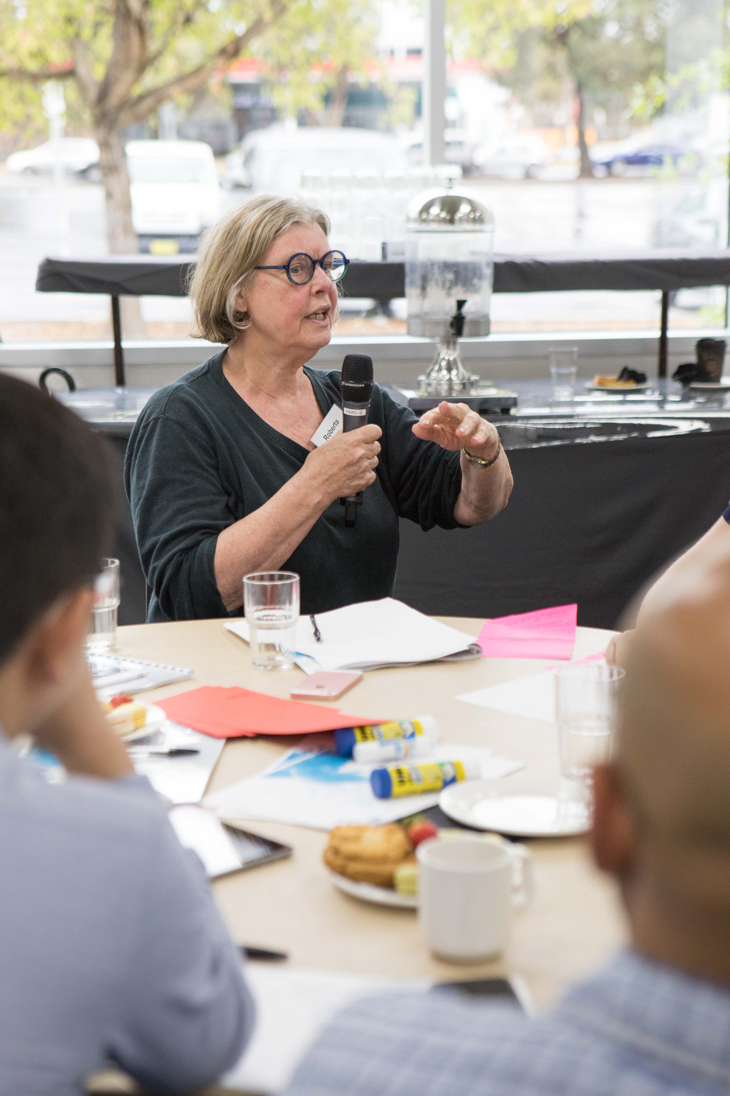
Future Network | Customer Engagement
Our People’s Panel sharing their views
Notes:
One of the key elements we engaged on with our customers was how we should prepare the grid for the future.
Throughout all of our customer engagement activities, we consistently heard that our customers want us to green the grid.
As our role includes connection of renewables energy sources, recommendation #4 calls for Jemena to enable more of these connections, and making the grid capable for customers to export back into the grid.
Customers also want us to investment more in smarter technology solutions during the 2021-2026 regulatory period where this would result in Jemena deferring or reducing expenditure post-2026 (recommendation #6).

Slide 17
Future network | Objectives
Enable DER
Enabling residential customers to export 5 kW back into the grid
Providing commercial / industrial customers with the option of dynamic exports, rather than no export (no cost) or full export (customer pays for upgrading the network)
Optimised Asset Investments
Optimise Replacement projects through condition monitoring
Optimise Augmentation projects through dynamic ratings
Initiative | Cost and categorisation
Enable DER
LV network model | $6.1 M capex (100% IT) $0.9M opex
Increase DER hosting capacity (network upgrades) | $8.4 M capex (100% Network) $1.8M opex
Increase DER hosting (dynamic control systems) | $9.0 M capex (27% Network, 73% IT) $1.0M opex
Optimised Asset Investments
Asset and Climate Sensors feeding into Asset Investment Systems | $4.9 M capex (41% Network, 59% IT)
Notes:
Taking the recommendations from our customers, Jemena has developed our Future Network Strategy with objectives of:
enabling customer to connect DER which can export to the grid, and
using technology to optimise asset investments
During the 2021-2026 regulatory period, Jemena is proposing to spend:
$23.5 million on enabling DER à focused on our internal IT/OT systems and network upgrades, to better plan and operate our low-voltage networks
$4.9 million on optimised asset investments à focused on real-time asset condition sensors and IT/OT systems to maximise the utilisation of existing assets

Slide 18
Future network | An Economic Need
Without action, more solar customers will be constrained from exporting
Modelling shows building a smarter grid maximises value for customers
Notes:
To determine the prudency of these future grid investments, we have undertaken cost benefit modelling to ensure the customer benefit is greater than the cost.
The chart of the left shows what will happen on our network as more and more customers connect solar (PV) systems, and want the ability to export to the grid.
The key elements of the chart include:
The orange bars show forecast uptake of PV customers
The blue line shows the percentage of PV customers which would experience some constraint on their ability to export to the grid, without investment to enable DER
The green line show how much the enable DER investment reduces the percentage of PV customers being constrained
The chart of the right shows the cost benefit comparison of the four options contained in our Future Grid Investment Proposal.
The key elements of this second chart include:
The grey bars showing the value to customers of enabling DER
The blue bars are showing the 2021-2026 investment for the four options
The orange dot then showing the net customer benefit (which is highest in the ‘build smart’ option)

Slide 19
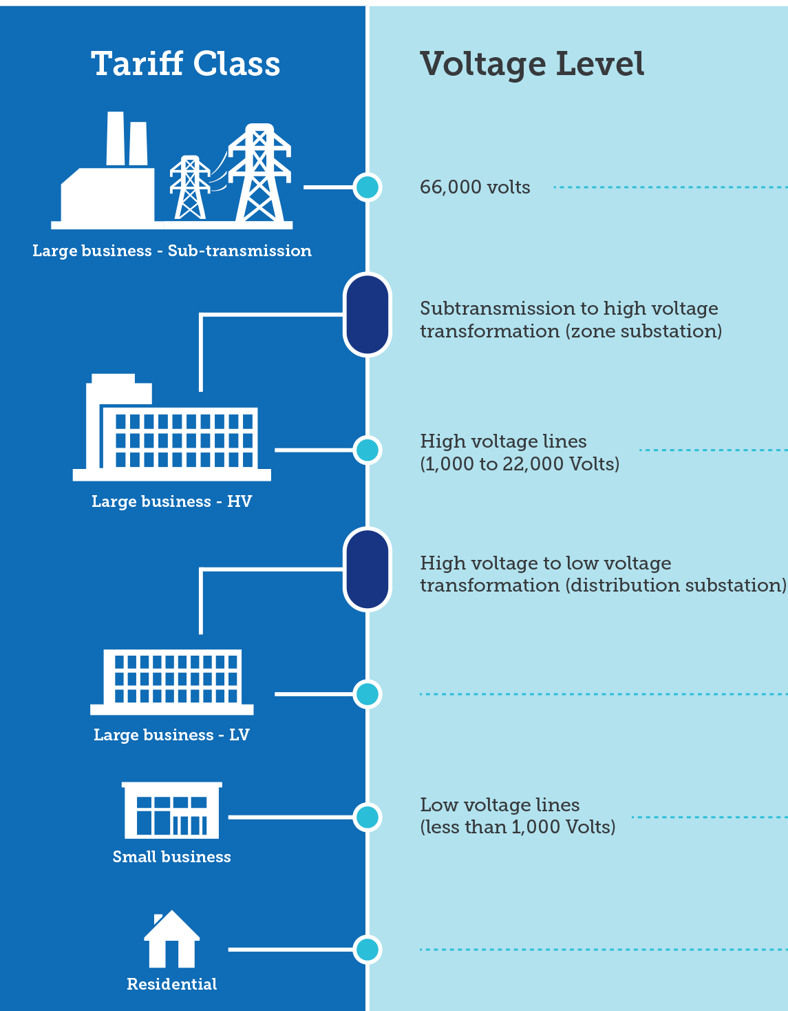
Network Pricing | Efficient network tariffs
With all Victorian networks, we have collaborated extensively on network tariffs with stakeholders
Large customers and small customers over 40MWh per annum
We will be replacing ratcheted demand with rolling demand to better recognise freed-up capacity
Small business customers
We are amending our time of use tariff to a shorter peak window (9am to 9pm; weekdays). This will be the default tariff for all customers with consumption < 40MWh per annum
Residential customers
Consistent with the other Victorian DB’s we are proposing a new ToU tariff (3pm to 9pm, all days). This tariff will be the default for new connections, DER and three-phase customers. Any customer who has chosen or been assigned to this tariff can choose to move to a single rate or demand tariff.

