Slide 1
Inflation Modelling Workshop Sydney – 9 August 2017
Mark Grenning
Eric Groom
Bev Hughson
Consumer
Challenge
Panel

Slide 2
Purpose and scope
Purpose of today is to agree on models and modelling
Not debate what the response should be
Specifically: do NSPs or their customers benefit or lose if actual inflation is above or below the assumed inflation?
Our results show they do not.
We used AER’s scenario model based on the PTRM/RFM.
It is a simplification but the results make sense.
To explain this we will set out:
The measures of impacts we used
The assumptions we used
The model we used
The results
Why the results are what they are

Slide 3
Measuring impacts
CPI-X regulation was designed to:
De-link revenues and costs to provide efficiency incentives
Remove inflation risk from utilities
Regulatory models under CPI-X approaches focus on:
Real prices
Real returns
It is a given, in the UK and abroad, that investors’ returns should allow for inflation, and that what matters are the real returns. (OXERA)
NPV neutrality
Hence, we assess impacts in terms of:
Do real prices change?
Is NPV neutrality maintained at the real discount rate?

Slide 4
Assumptions
Common assumptions
Scenarios:
Inflation Assumption | 2.5% (constant)
Real WACC | 5.0% (constant)
Opex | 0 (to abstract from its impact)
Capex | 1000 in year 0, 100
Depreciation | Straight-line, 30 year asset life

Slide 5
Model Used
Model used:
https://www.aer.gov.au/networks-pipelines/guidelines-schemes-models-reviews/roll-forward-model-distribution-december-2016-amendment/initiation.
Scenario generator running off the AER PTRM and RFM.
Use of the PTRM and RFM is important
Scenario generator makes it easier to compare different options
It was developed by the AER but we have used it independently of the AER.

Slide 6
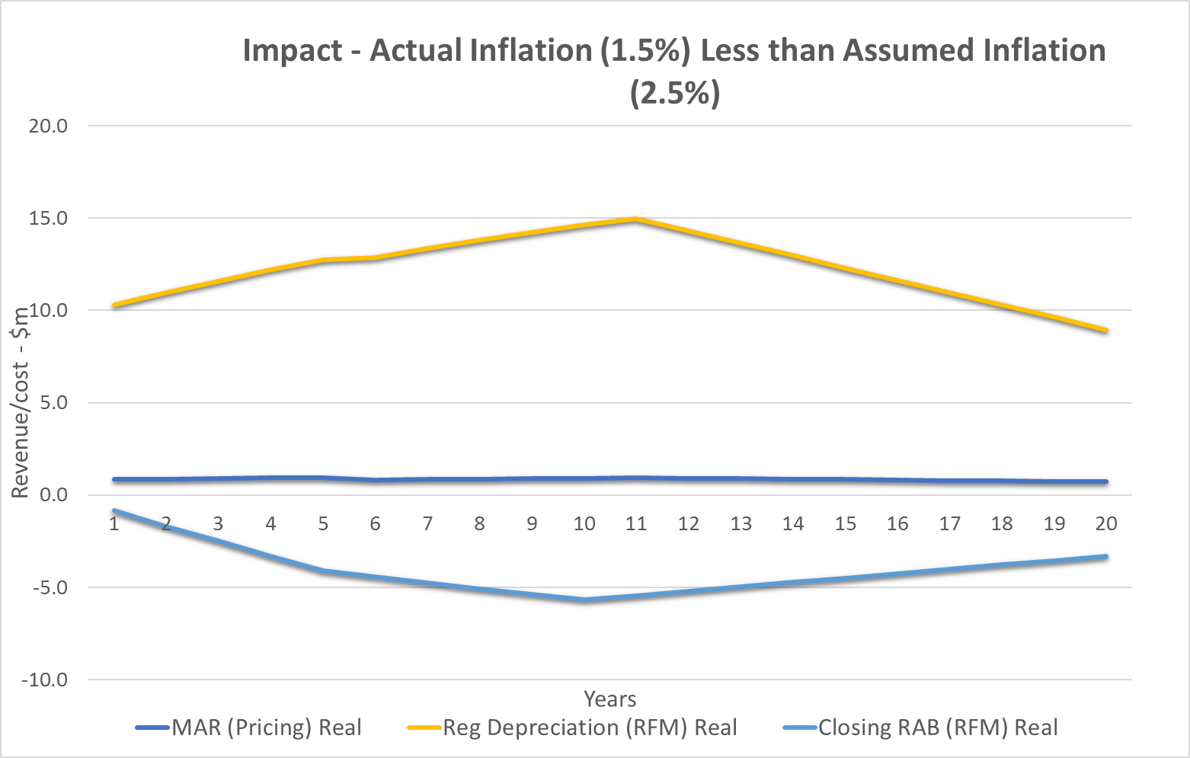
Results: Low Actual Inflation
Small positive NPV of $16.73m (1.6% of cash flows)
Small increase in real prices (1% higher in first period
Full results in spreadsheets provided

Slide 7
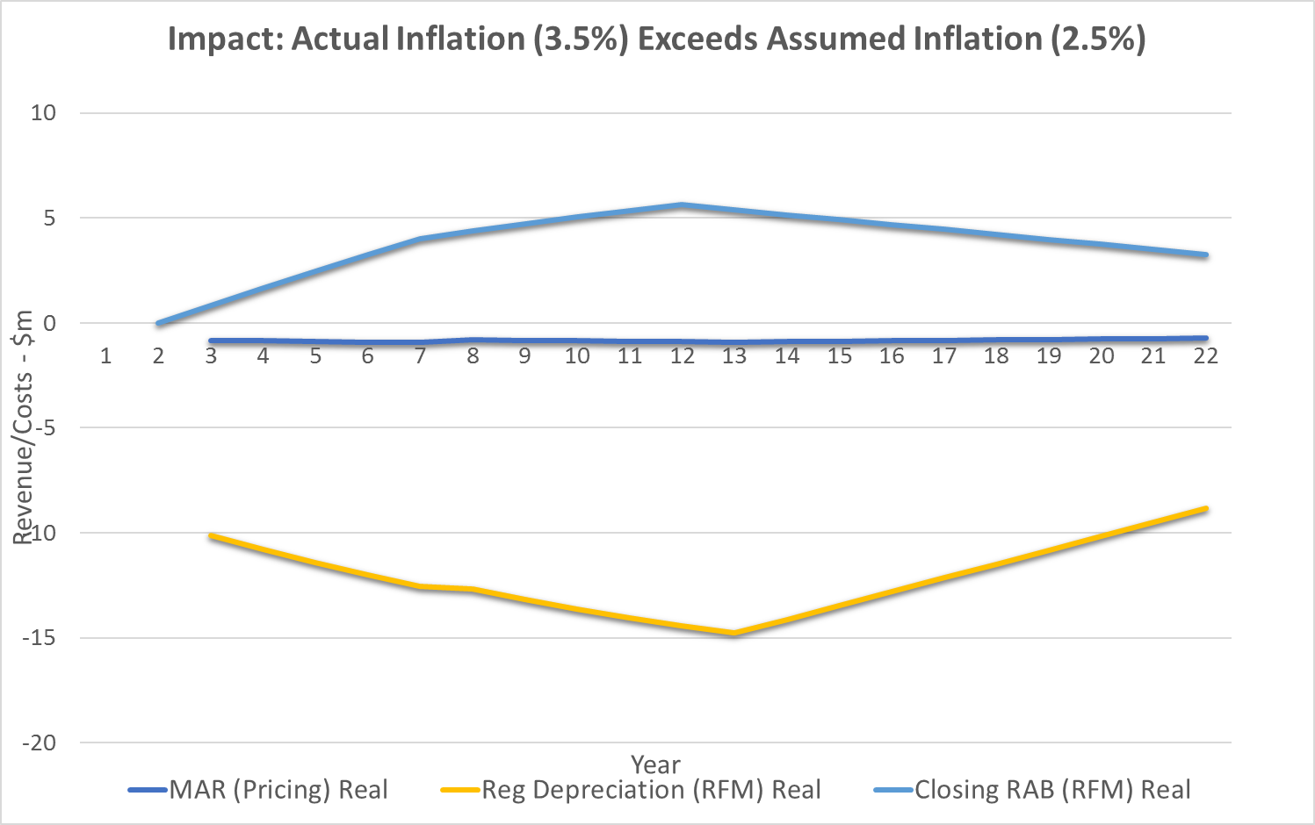
Results: High Actual Inflation
Small negative NPV of $16.50m (1.6% of cash flows)
Small decrease in real prices (1% higher in first period
Full results in spreadsheets provided

Slide 8
Understanding the results
Concern raised that:
Depreciation reduced at start of period using forecast inflation
At the end of the period the RAB is indexed for actual inflation but no adjustment is made to the depreciation reduction
NSP may be worse off if actual inflation is less than assumed
But the indexing prices for actual inflation corrects this
All components of forecast revenues reflect expected real outcomes and costs at start of period
During the period total revenue – and hence all components – are adjusted for actual inflation, including depreciation
Hence there is no inconsistency (except year 1)

Slide 9
Understanding the results
Why is there a ‘first year effect’
Revenues in the first year of the period are set in nominal terms based on expected inflation and not adjusted for actual inflation
Other points to note:
RAB in the RFM reflects actual inflation only.
Difference between prices modelled at start (MAR PTRM) and actual prices (MAR Pricing) reflects difference between forecast and actual inflation applied to all revenue – including depreciation allowance.

Slide 10
Thank you

