Slide 1
Demand Management Workshop
Electricity Distribution Price Review 2016 - 2020

Slide 2
Overview
Why customers benefit from Demand Management and DMIA
Recent and current projects
Proposal for 2016-20
Rationale for proposed projects

Slide 3
Why customers benefit from DM
Efficiently defer long-lived augmentation capex and minimise RAB growth, reducing long-term price pressure
Building a broad base of dispatchable demand response (e.g. direct load control of air conditioning) reduces long-term augmentation capex, and provides a number of indirect benefits including:
  Increased flexibility to respond to contingency events, improving network resilience;
  A mechanism to improve power quality; and
  Enhanced ability for customers to manage their own consumption.

Slide 4
Why customers benefit from DMIA
Encourages innovation to deliver future efficiency savings
  Innovative changes to processes, work practices and technical solutions can deliver cost efficiencies running into the future, reducing the long term cost of network services to consumers
Addresses truncated returns on R&D in regulated sector
  In a regulated environment, the benefit of the R&D is truncated as expenditure incentives for opex and capex operate over a five year period;
  Many R&D investments involve longer payback periods (e.g. residential battery storage trial), and higher levels of uncertainty around project benefits than more traditional cost saving initiatives (e.g. process improvements); and
  These factors mean an innovation allowance is necessary to foster innovation in regulated sectors.

Slide 5
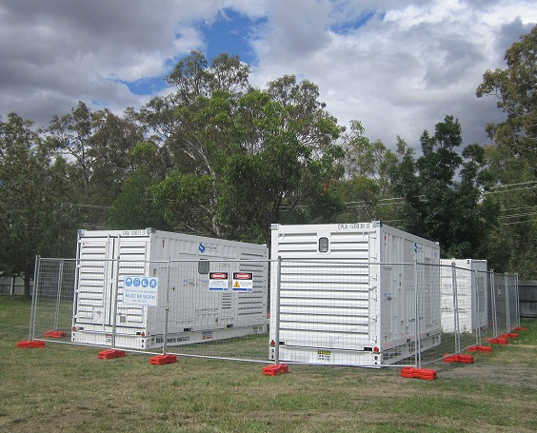
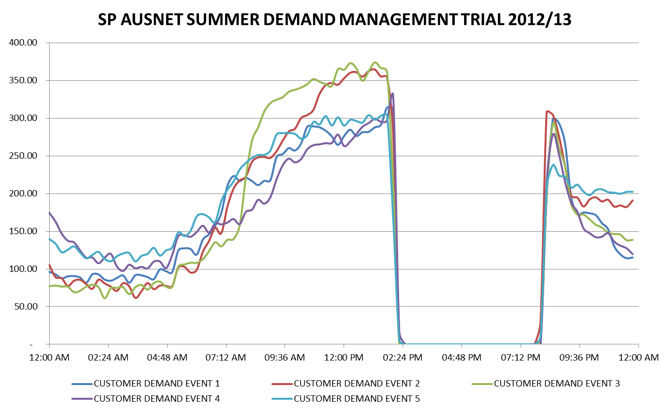
Recent and current projects: DM
Deferral of Benalla to Euroa 22kV feeder upgrade
Mobile generation sets
C&I demand response

Slide 6
Recent and current projects: DM
Critical Peak Demand Tariff for large customers

Slide 7
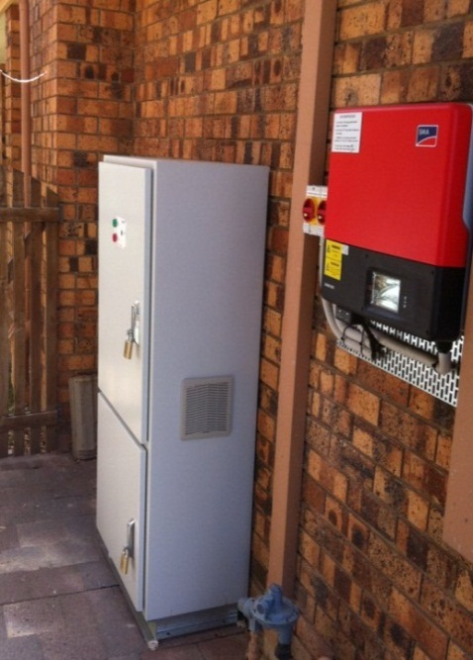
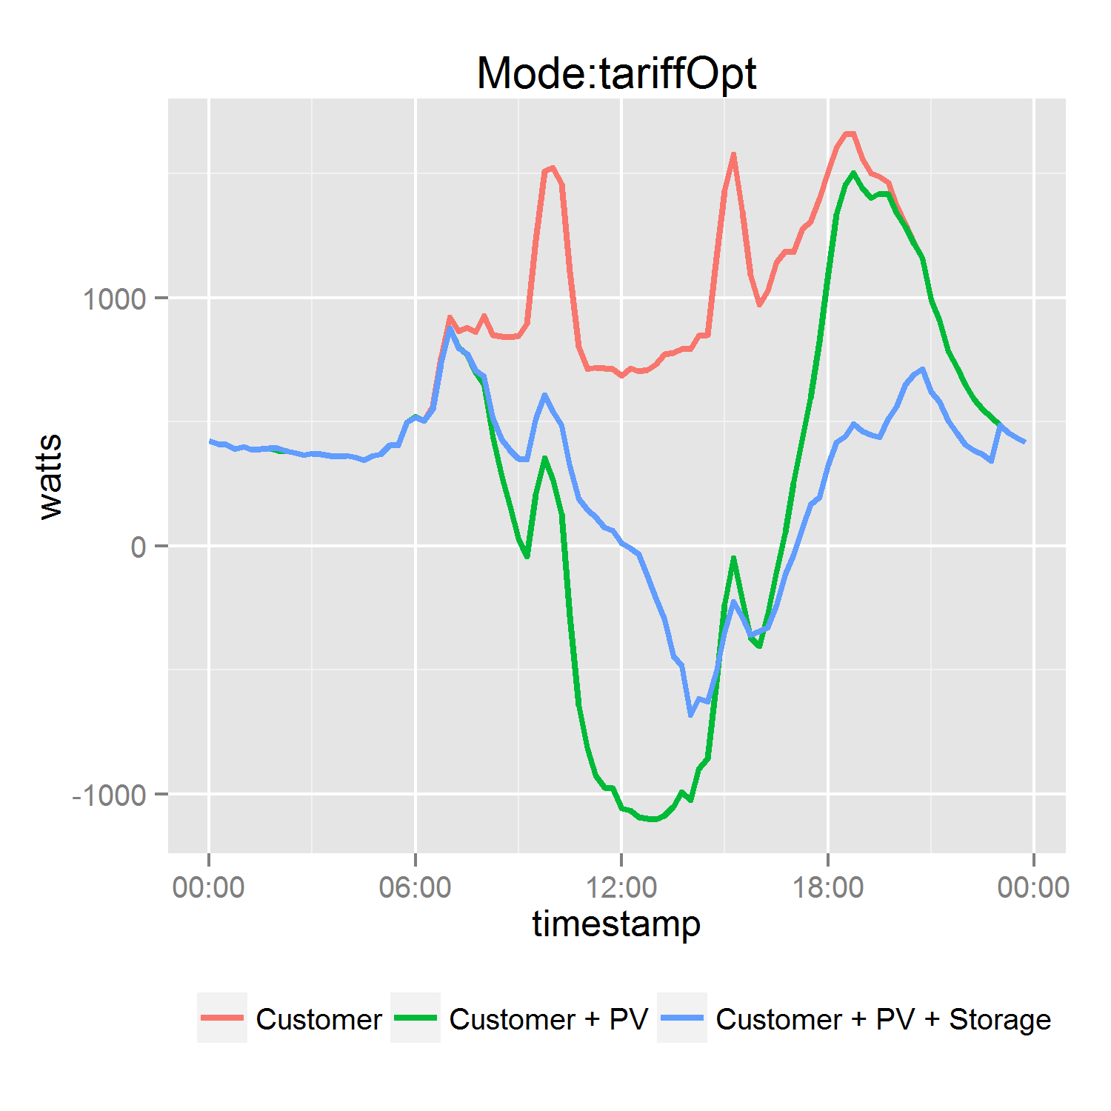
Recent and current projects: DMIA
Residential Battery Storage Trial

Slide 8
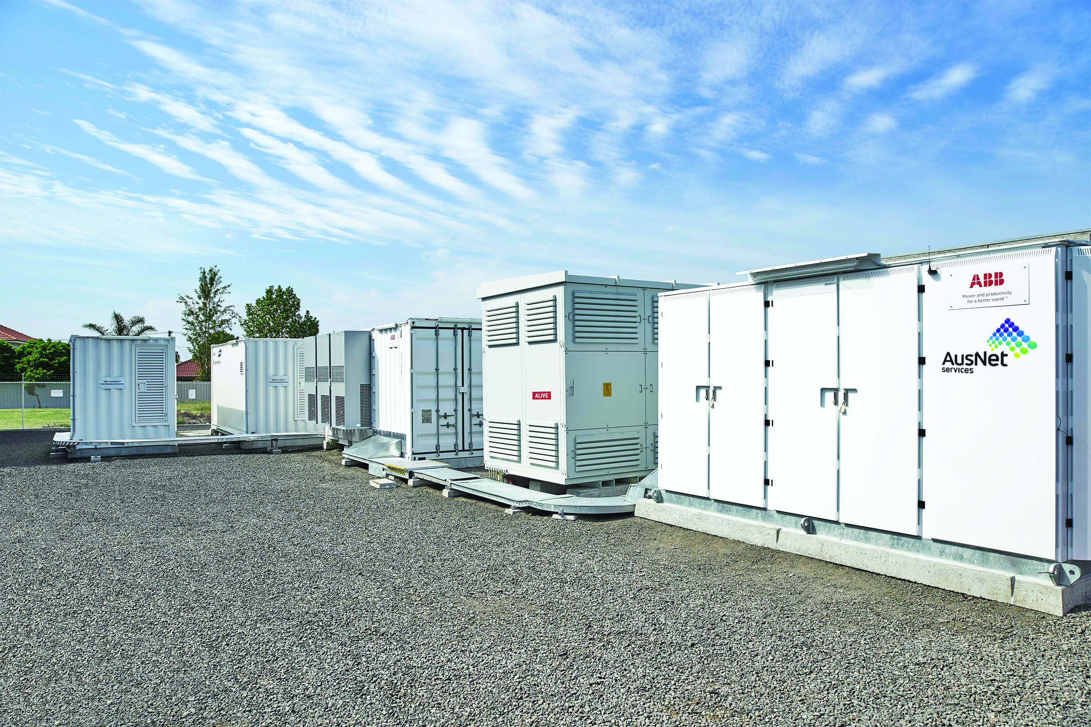
Recent and current projects: DMIA
Grid Energy Storage System trial

Slide 9

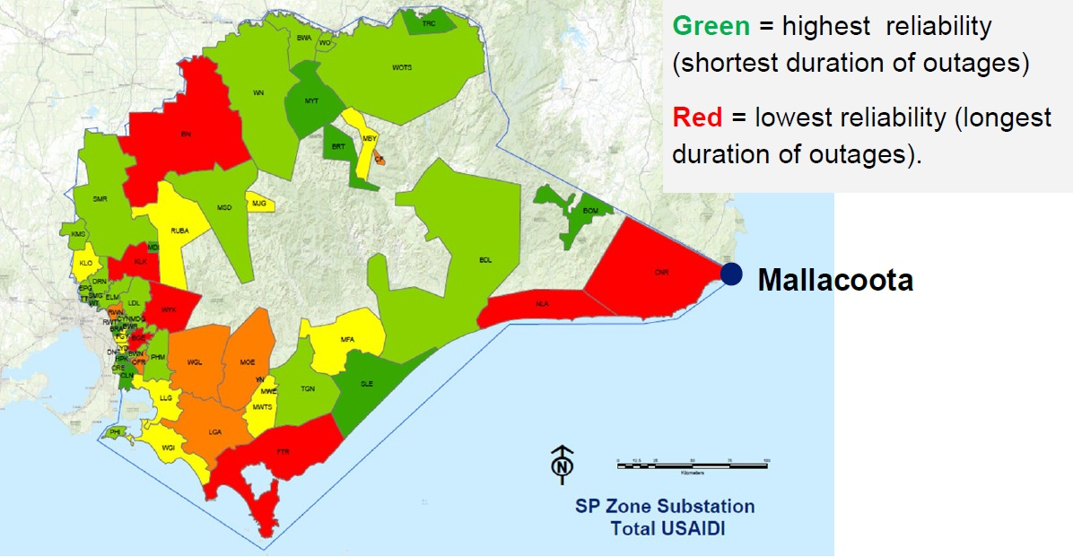
Recent and current projects: DMIA
Mallacoota Sustainable Energy Study

Slide 10
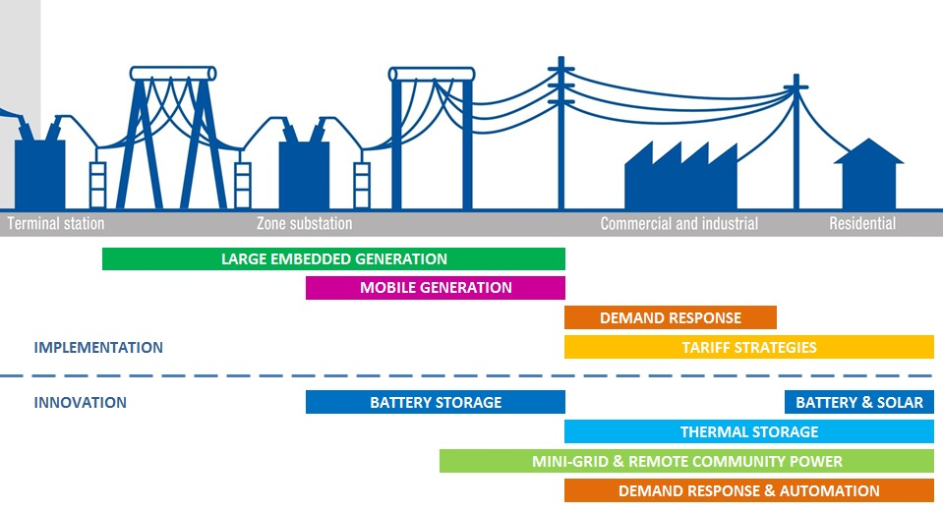
Proposal for 2016-20
Overview of DM activities across the distribution network

Slide 11
Proposal for 2016-20
Transfer of DM innovation into BaU
DMIA PROPOSAL
INNOVATION
Rapid transfer projects
INNOVATION
Strategic initiatives
Further innovation & trials
NEW DM TECHNIQUES
Targeted projects
Future implementation
NEW DM TECHNIQUES
Broad-based programs
Future impact and customer benefits
DM OPEX PROPOSAL
MATURE DM TECHNIQUES
Targeted projects
DEMAND SIDE ENGAGEMENT PROCESS
2016-20 REGULATORY PERIOD
2021-25 REGULATORY PERIOD

Slide 12
Proposal for 2016-20
Summary of proposed expenditure
Component | Proposed expenditure $m
Engineering expertise, Demand Side Engagement | 5.3
Existing capex deferral projects | 1.7
Initiate new capex deferral projects | 0.7
Energy at risk reduction projects | 3.6
Broad-based demand management | 1.6
Total DM opex forecast | 13.0
Total DM opex step change | 4.8
Demand Management Innovation Allowance | 10.0
DM & DMIA program equivalent to 2% of total opex proposal

Slide 13
Rationale for proposed projects
Deferral of capital expenditure ($2.4m)
  Managing demand can economically avoid or defer capacity upgrades
  Provides flexibility in responding to changing demand levels
  Existing deferral of rural feeders and zone substation transformers
  New opportunities mainly in urban growth corridors
Reduction of energy at risk ($3.6m)
  DM implemented to reduce the risk of customers losing supply
  Applicable where an asset has a relatively low risk of overload, and where capacity upgrade is not yet required
  May lead to future deferral of upgrades if demand growth continues
  Example: zone substation transformer upgrades

Slide 14
Rationale for proposed projects
Broad-based DM programs ($1.6m)
  May comprise many small initiatives that take time to roll-out
    Example: Air-conditioning load control
  Seek to reduce the growth in demand across a wide area, rather than focus on a single demand constraint
  Reduces the long-term (beyond next period) need for asset augmentation
  Best directed to areas of high demand growth
Demand Management Innovation Allowance ($10.0m)
  Developing a residential DM capability critical to address urban growth corridors
  Battery storage needs to be tested at scale, technically & commercially
  Technology options to optimise C&I DM portfolio and integrate into BaU
  Mini-grids and remote energy supplies offer potential cost savings and reliability benefits

