Slide 1
Australian Energy Regulator
AER Preliminary decisions for Energex and Ergon Energy 2015−20
Conference
12 May 2015

Slide 2
Today’s agenda
Welcome – Paula Conboy, AER Chair
Presentations from:
Sebastian Roberts, General Manager, AER
Hugh Grant and Bruce Mountain, AER Consumer Challenge Panel
Time for questions after presentations

Slide 3
Our preliminary decisions
Our preliminary decisions reflect changes to the National Electricity Rules in 2012
There are 24 constituent decisions covering revenue, operating and capital allowances, amongst other things
We set the revenue a business may recover from customers, not its costs
Preliminary decisions – used to set prices for 2015−16

Slide 4
AER process
Some highlights of the AER’s process:
This decision implements the AER’s better regulation program
Extensive consultation with stakeholders
Input from Consumer Challenge Panel
Consideration of 72 submissions on Energex and Ergon Energy’s proposals
Engineering input from AER’s Technical Advisory Group
Consultant input from Deloitte and EMCa

Slide 5
Energex – total revenue
Energex's past total revenue, proposed total revenue and AER preliminary decision revenue allowance ($ million, 2014−15)

Slide 6
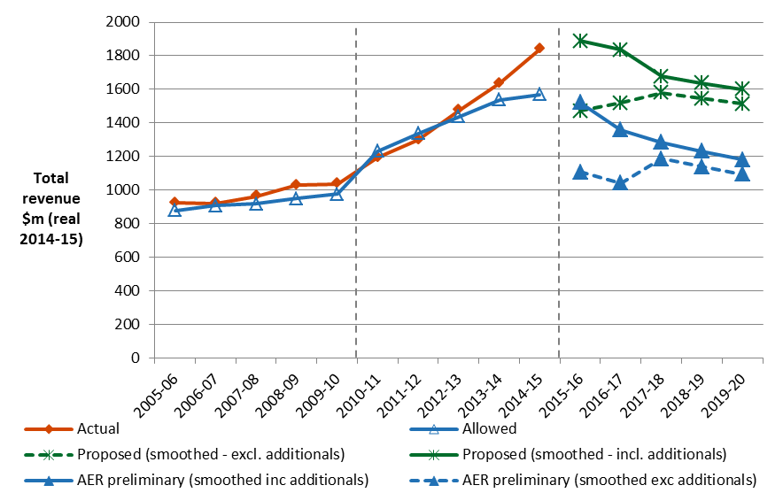
Ergon Energy – total revenue
Ergon Energy's past and proposed total revenue and AER preliminary decision revenue allowance ($ million, 2014–15)

Slide 7
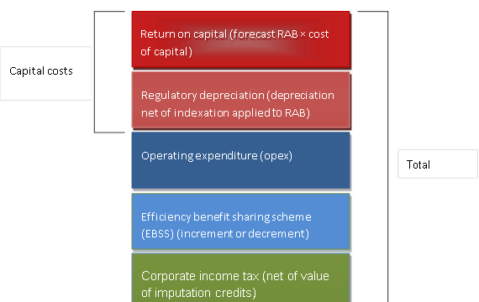
AER approach – building blocks

Slide 8
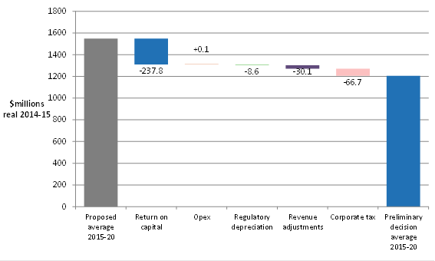
Energex – building blocks
AER's preliminary decision and Energex's proposed annual building block costs ($ million 2014−15)

Slide 9
Ergon Energy – building blocks
AER's preliminary decision and Ergon Energy's proposed annual building block costs ($ million 2014−15)

Slide 10
Indicative bill impacts
Network business | Business proposal | AER preliminary decision | Percentage difference | Expected bill reduction for average household by end of 2015–20
Energex | $8432 million | $6528 million | -23 per cent | $132
Ergon Energy | $8242 million | $6022 million | -27 per cent
Note: Due to the Queensland Government uniform tariff policy, Ergon Energy’s revenue reduction will not flow through to its residential customers. Instead, the bill impact will mirror that of Energex.

Slide 11
Rate of return
 | AER decision 2010–15 | Energex’s proposal 2015–16 | Ergon Energy's proposal 2015–16 | AER preliminary decision 2015–16 | AER preliminary decision 2016–20
Nominal risk free rate (return on equity) | 5.89% | 3.63% | 3.63% | 2.55% | 2.55%
Nominal post–tax return on equity | 11.09% | 10.50% | 10.50% | 7.1% | 7.1%
Nominal pre–tax return on debt | 8.87% | 5.91% | 6.36% | 5.01% | Updated annually
Nominal vanilla WACC | 9.72% | 7.75% | 8.02% | 5.85% | Updated annually

Slide 12
Energex’s rate of return parameters (nominal)
 | AER decision 2010–15 | Energex's proposal 2015–20 | AER preliminary decision 2015–16 | AER preliminary decision 2016–20
Nominal risk free rate (return on equity) (a) | 5.89% | 3.63% | 2.55% | 2.55%
Equity risk premium (b) = (c*d) | 5.20% | 6.87% | 4.55% | 4.55%
MRP (c) | 6.50% | 7.57% | 6.50% | 6.50%
Beta (d) | 0.8 | 0.91 | 0.7 | 0.7
Nominal post–tax return on equity (e) = (a) + (b) | 11.09% | 10.50% | 7.1% | 7.1%
Nominal pre–tax return on debt (f) | 8.87% | 5.91% | 5.01% | Updated annually
Gearing | 60% | 60% | 60% | 60%
Nominal vanilla WACC = 0.4*(e) + 0.6*(f) | 9.72% | 7.75% | 5.85% | Updated annually
Forecast Inflation | 2.52% | 2.52% | 2.55% | 2.55%

Slide 13
Ergon Energy’s rate of return parameters (nominal)
 | AER decision 2010–15 | Energex's proposal 2015–20 | AER preliminary decision 2015–16 | AER preliminary decision 2016–20
Nominal risk free rate (return on equity) (a) | 5.89% | 3.63% | 2.55% | 2.55%
Equity risk premium (b) = (c*d) | 5.20% | 6.87% | 4.55% | 4.55%
MRP (c) | 6.50% | 7.57% | 6.50% | 6.50%
Beta (d) | 0.8 | 0.91 | 0.7 | 0.7
Nominal post–tax return on equity (e) = (a) + (b) | 11.09% | 10.50% | 7.1% | 7.1%
Nominal pre–tax return on debt (f) | 8.87% | 6.36% | 5.01% | Updated annually
Gearing | 60% | 60% | 60% | 60%
Nominal vanilla WACC = 0.4*(e) + 0.6*(f) | 9.76% | 8.02% | 5.85% | Updated annually
Forecast Inflation | 2.52% | 2.57% | 2.55% | 2.55%

Slide 14
Cost of debt - trailing average
Our starting point for existing debt is continuation of on-the-day approach
Then new debt is incorporated as it is progressively refinanced each year
10 year trailing average
10% of debt notionally re-financed each year
The benefit? Less price volatility for consumers

Slide 15
Energex - opex
Energex's proposal compared to AER alternative forecast and past opex ($ million, 2014-15)

Slide 16
Ergon Energy - opex
AER preliminary decision compared to Ergon Energy's past and proposed opex ($million, 2014-15)

Slide 17
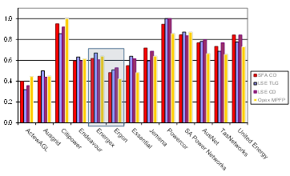
Benchmarking performance
Opex efficiency scores

Slide 18
Deloitte review of efficiency
QLD government initiated an efficiency review in 2012 of both Energex and Ergon
Deloitte has reviewed progress since then. Main findings:
Significant efficiency gains since review
But service providers have not addressed all recommendations
Ongoing restrictive EBA provisions
Limited outsourcing
Energex and Ergon have identified further efficiency gains

Slide 19
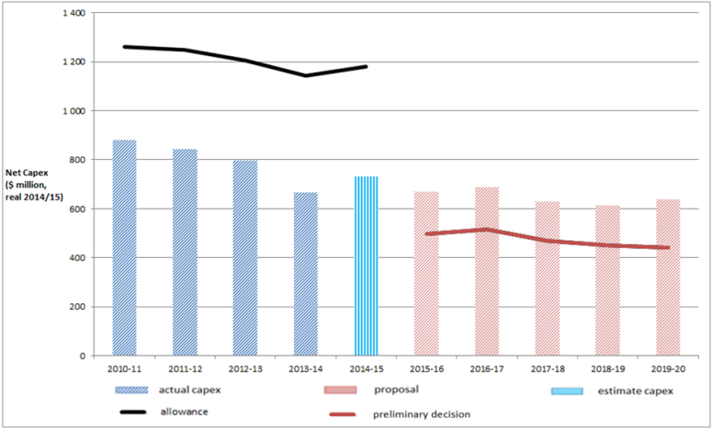
Energex - capex
AER preliminary decision compared to Energex’s past and proposed capex ($million, 2014-15)

Slide 20
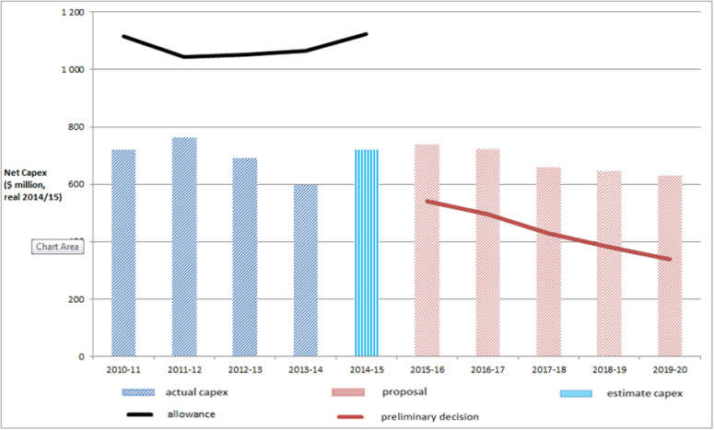
Ergon Energy - capex
AER preliminary decision compared to Ergon Energy's past and proposed capex ($million, 2014-15)

Slide 21
Metering services in Qld
Our preliminary decision approves two types of metering service charges:
Upfront capital charge (for all new and upgraded meters installed from 1 July 2015)
Annual charge comprising of two components:
capital—metering asset base (MAB) recovery
non-capital—operating expenditure and tax.
No upfront charges for replacement meters

Slide 22
CCP presentations

Slide 23
Next steps in Qld reset
All queries, forum registrations etc. to Qldelectricity2015@aer.gov.au
Date | Step
26 May 2015 | AER jurisdictional consumer forum
3 July 2015 | Submissions on AER preliminary decisions close
3 July 2015 | Qld distributors’ revised proposals due
24 July 2015 | Submissions on Qld distributors’ revised proposals close
31 October 2015 | AER releases final decision for Qld businesses

